Slide 1
Al-based automated defective exhibit identification system placed in a gallery

Slide 2
Exhibit Defect Detection System
The AI-based automated defective exhibit identification system utilizes advanced image processing and machine learning techniques to detect flaws in gallery exhibits.
By analyzing images in real-time, the system ensures exhibits are defect-free, enhancing the quality and visitor experience while minimizing manual inspection efforts.
Maintenance Challenge Unnoticed
High Maintenance Needs
Frustrating Visitor Experience
Missed Learning Opportunities
AI-based Defect Detection

Slide 3
Exhibit Defect Detection System Workflow
Anomaly
YES
Report
Anomaly
Hardware
CNN
Monitoring/
Charging
NO
Anomaly
YES
Report
Anomaly
Defect Detection System
Software
Mail sent to Officials
Centralized
App
App with ML
Monitoring/
Charging
NO
Manual
Indication
Report
Anomaly

Slide 4



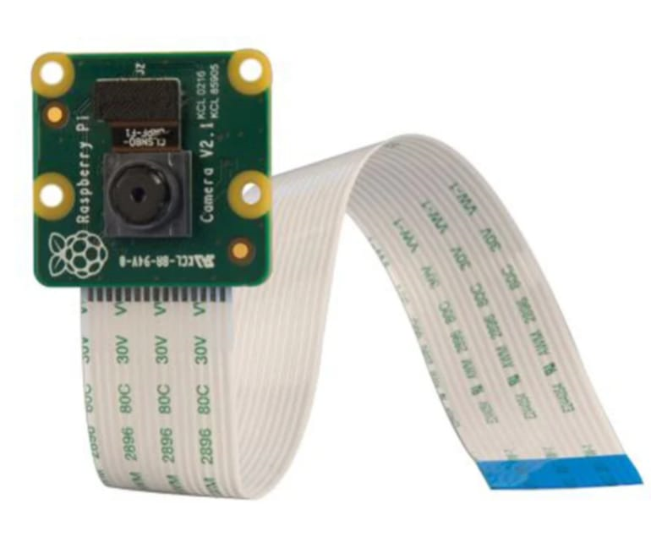




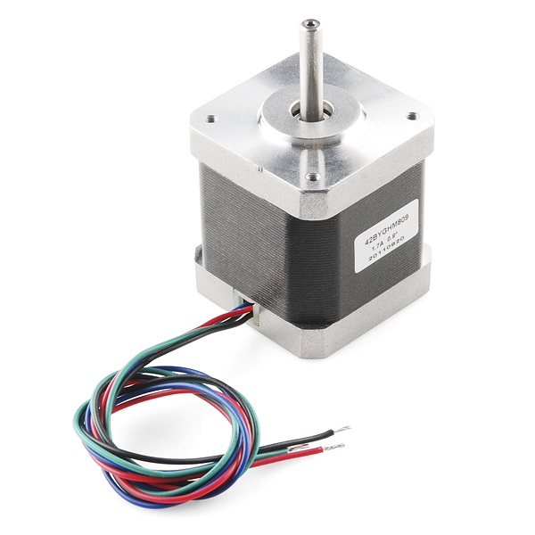
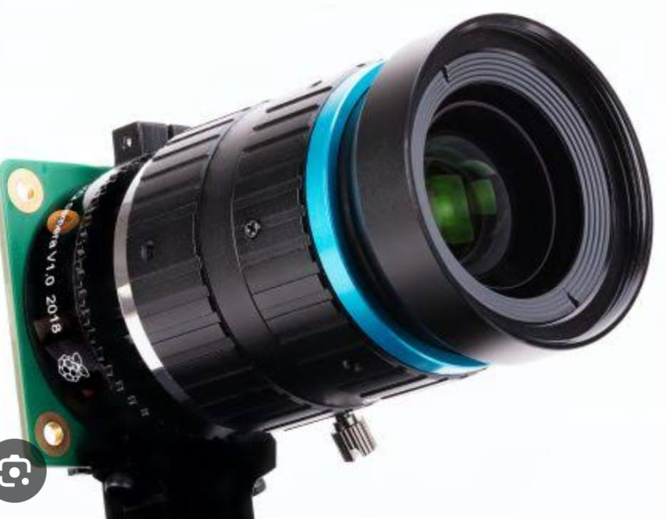






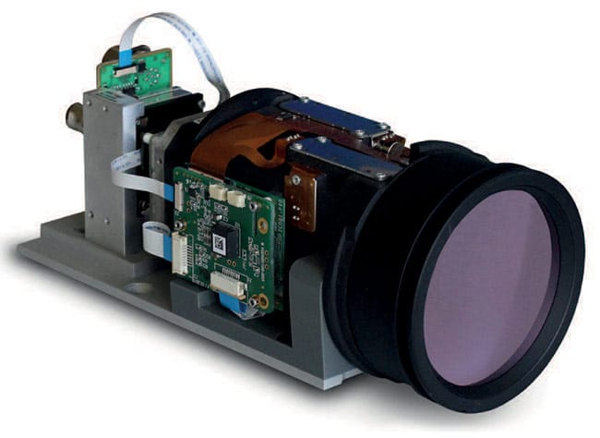
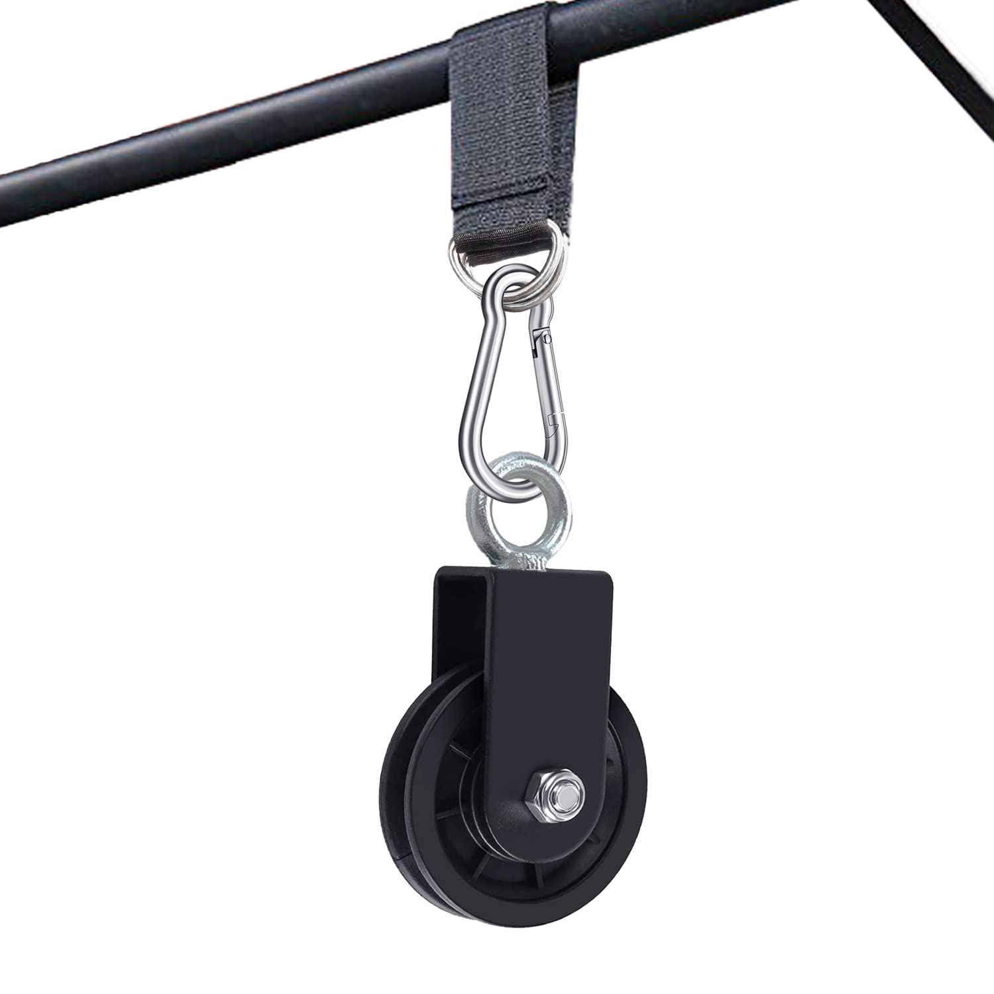
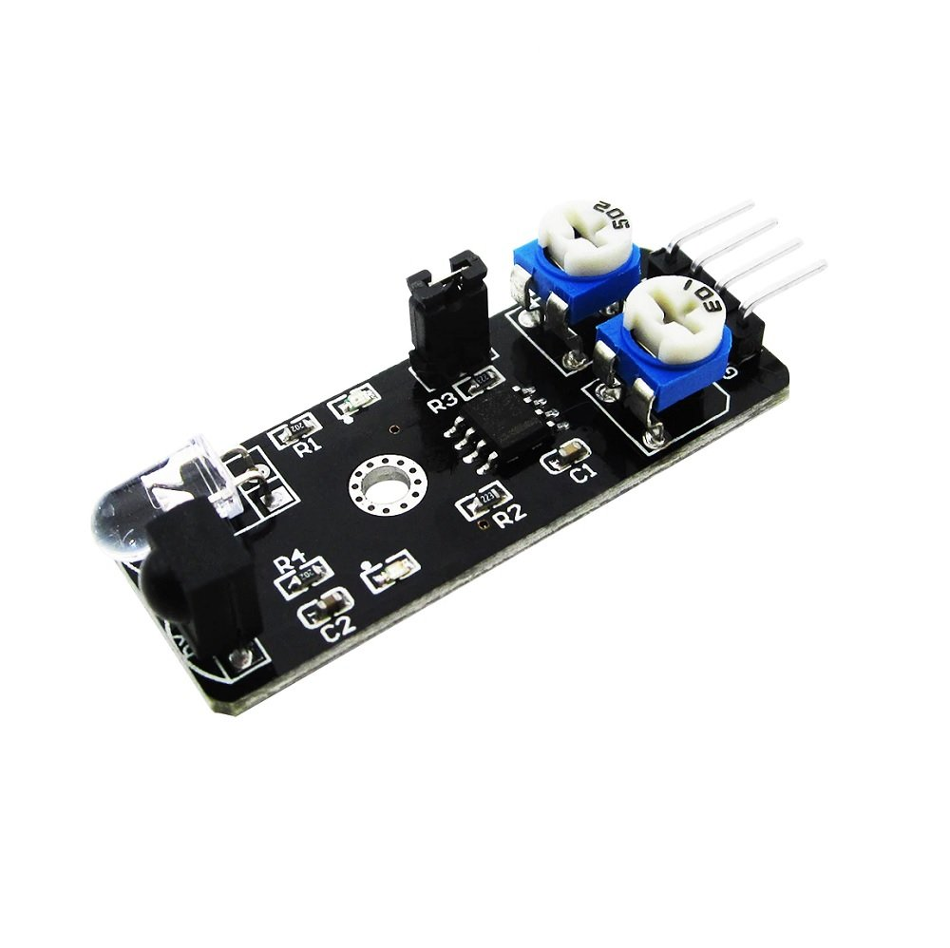


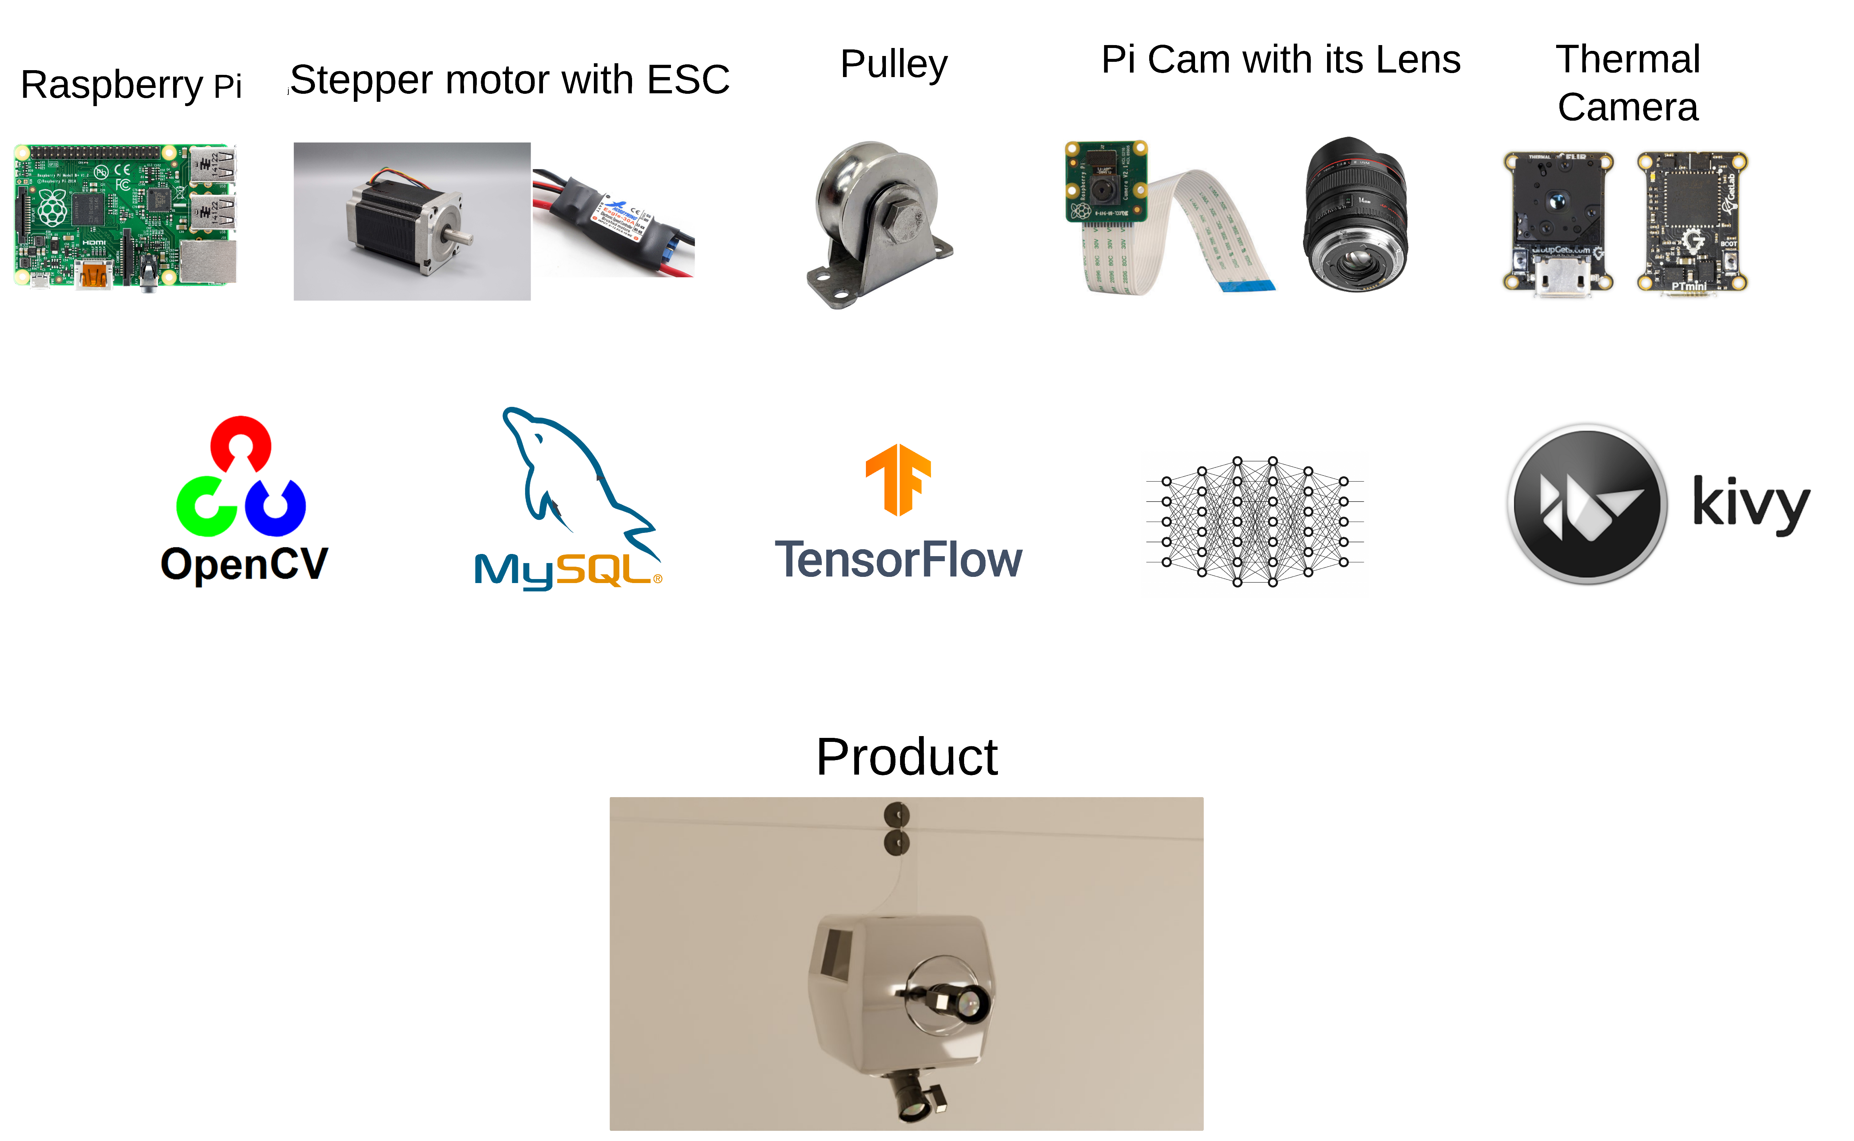


01
Raspberry Pi
Pi Cam
05
Compact computer for various projects.
Camera module for Raspberry Pi
02
Stepper motor
Pi Cam’s lens
06
Precise motor for controlled rotation.
Optics for Pi Cam’s image capture
Hardware and Software
Requirements
03
ESC
Thermal Camera
07
Regulates speed and direction of motors
Detects heat and visualizes temperature differences
04
Pulley
Obstacle Avoidance Sensor
08
Mechanism to transfer rotational motion
Detect and avoid the obstacles for navigation

Slide 5

Exhibit Defect Detection System Workflow Demo and References
Workflow Demo
References
Model Museum
https://www.exploratorium.edu/exhibits
Journals
A Survey of Defect Detection Techniques in Automated Visual Inspection“, IEEE Transactions on Industrial Informatics.
Deep Learning for Defect Detection: A Survey“, Computers in Industry.
Real-Time Surface Defect Detection System Using Convolutional Neural Networks, Journal of Manufacturing Processes
Image-Based Defect Detection for Cultural Heritage Conservation, Journal of Cultural Heritage
Automated Visual Inspection System for Defect Detection in Printed Surfaces, IEEE Access
@SIH Idea submission- Template
5

Slide 6
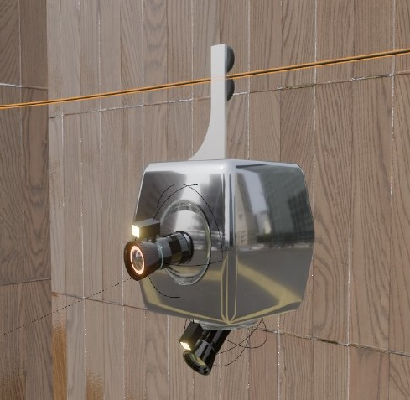




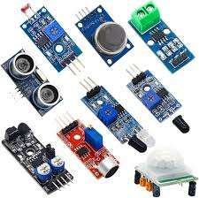

Exhibit Defect Detection System Feasibility
Drones
Machine learning models
Adaptable to other applications
Central server management
QR codes
Sensors

Slide 7





Exhibit Defect Detection System Viability
Improved Visitor Experience
Accuracy and Precision
Real-Time Monitoring
Scalability
Cost-Effectiveness
Using advanced AI & image processing techniques to detect even minor defects, ensuring high levels of accuracy in maintaining exhibit quality
Analyze images in real-time, allowing for immediate identification & correction of defects, which is crucial in maintaining the integrity of exhibits
Easily scaled to monitor large number of exhibits, making it suitable for galleries of various sizes and types, from small museums to large exhibitions
Reducing the need for manual inspection, the system lowers labor costs and minimizes the risk of human error, providing long-term cost savings
Consistent defect-free exhibits enhance the overall visitor experience, increasing the likelihood of repeat visits and positive reviews

Slide 8





Exhibit Defect Detection System Impact and Benefits
Reduced frustration
Continuous learning
Drone as exhibit
Impact
Improved uptime
Better Experience
Functional exhibits maintain educational flow
1.
Automated inspections
2.
Early defect detection
3.
Instant alerts to staff
Benefits
4.
AI and drone integration
5.
Visitor retention and satisfaction
6.
Expandable and adaptable system

